Slide 1
MP2-SRT: JAVA/JEE
MINI-PROJECT
MANAGEMENT OF AN ONLIGNE LIBRARY
DIGITAL BIT RARY
Established by: SGHAIER Med Oussema
GMAIL: stratosphu4basic@gmail.com
http://www.free-powerpoint-templates-design.com

Slide 2
Summery Plan
01
Introduction
02
Objectives
03
Specification & Description
04
Worksheet design
05
Development process
06
Conclusion

Slide 3
INTRODUCTION
Problematic:
Develop a web application of a virtual library of PDF books.
Easy to access and can read books, anytime anywhere.
Push print books Readers to read eBooks instead,
As they are more durable and ecofriendly.
80%
Around 80% off book sales around the world is print book. They are costly to make, responsible for trees-cutting, sensible for natural-condutions and can fade by time.
EBooks are much more
accessible
And durable
Takes Time, and expensive to make, takes space. can be lost or destroyed.
20%
80%

Slide 4
OBJECTIVES
What is DIGITAL BIT RARY ?
DIGITAL BIT RARY (DBR) is a web platform that allows users to access a library of electronic books (e-books).
User can login to DBR platform throw his account and:
EXIMINE BOOKS
DOWNLOAD&UPLOAD
SIGNUP&LOGIN
MODIFY&REMOVE BOOKS

Slide 5
Project Specification & Description

Slide 6
Project Specification & Description
Fonctions Description
- Manage the application
- User Registration
- Create acount
- Modify/Upload content
- Manage his profile
User
Admin
- Manage users account
- Login
- Login
As a user
As a Host
- Create & manage account
- Upload/download books
- Examine books
- Upload & download Books
- Examine books

Slide 7
Worksheet design

Slide 8


DIGITAL BIT RARY Application Structure
Spring-boot
Starter-JPA
Spring-boot
Starter-web
Spring-boot
Starter-
Security
DATABASE

Slide 9
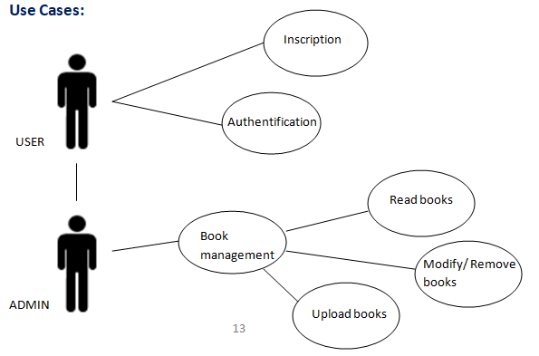
Analysis Models
Use
Cases
Model

Slide 10
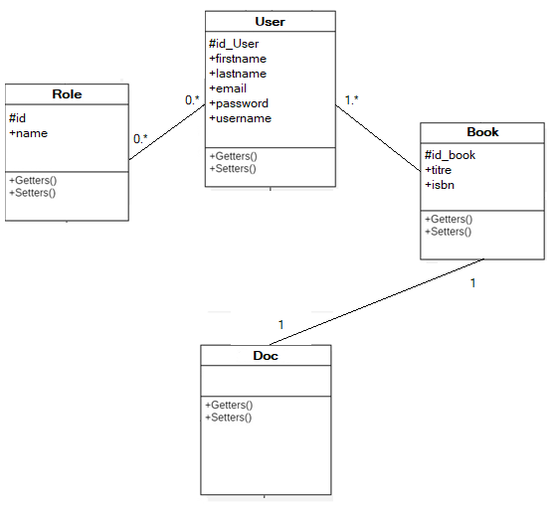
Analysis Models
Class
Diagram

Slide 11
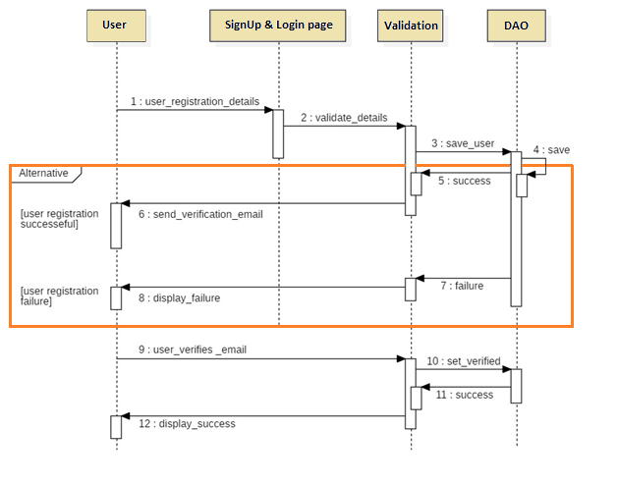
Analysis Models
Sequence Diagrams:
Registration

Slide 12
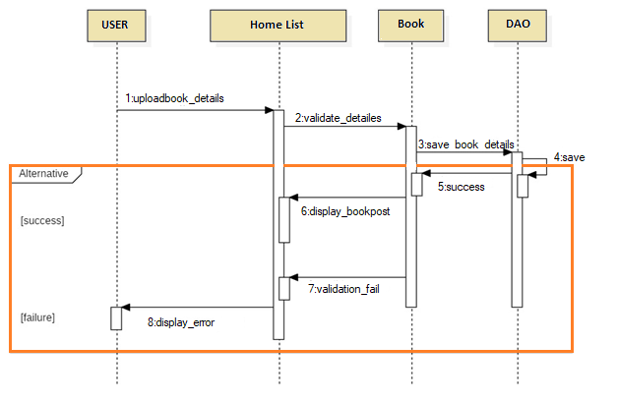
Analysis Models
Sequence Diagrams:
Upload

Slide 13
Development process

Slide 14





Development environment & Tools
Tools:
- Windows 10 OS
- MySQL
-Thymeleaf
- SpringToolSuite4 IDE
- StarUML

Slide 15
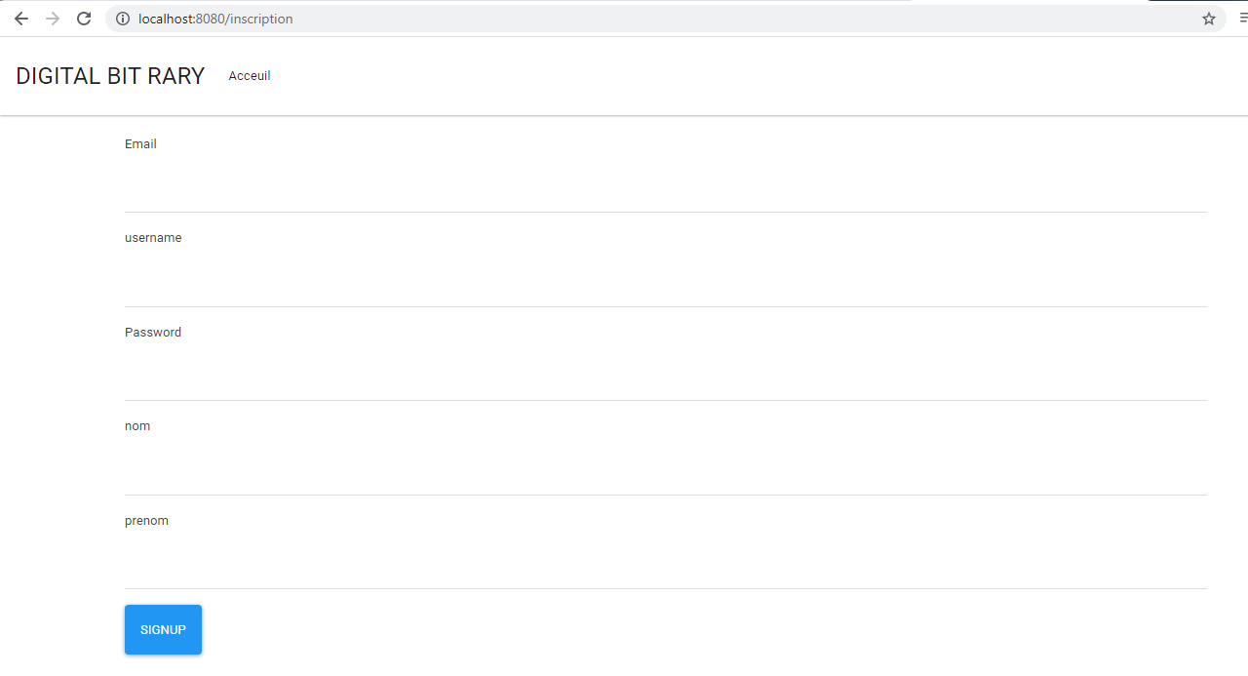
Web Pages
SignUp page :

Slide 16
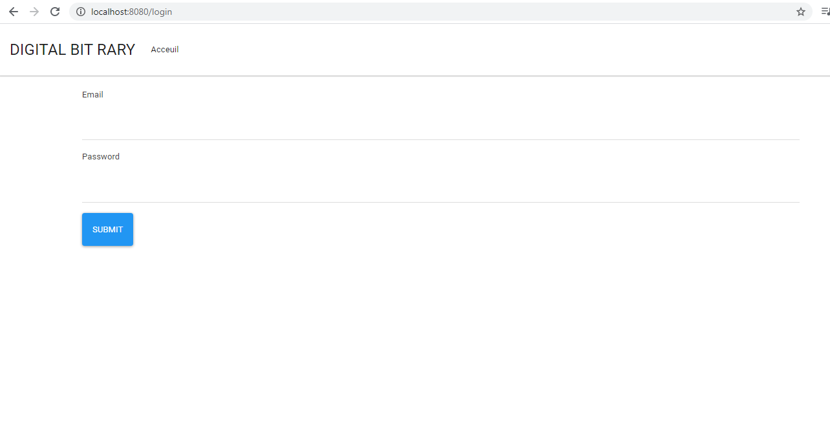
Web Pages
Login page :

Slide 17
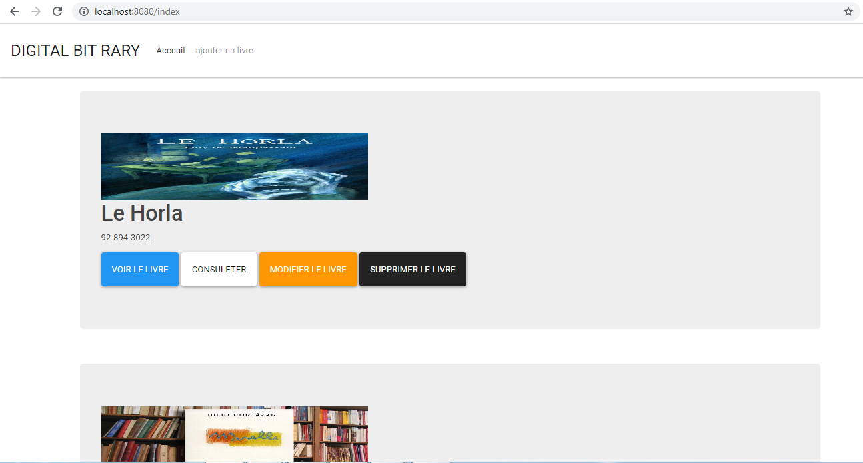
Web Pages
Home page :

Slide 18
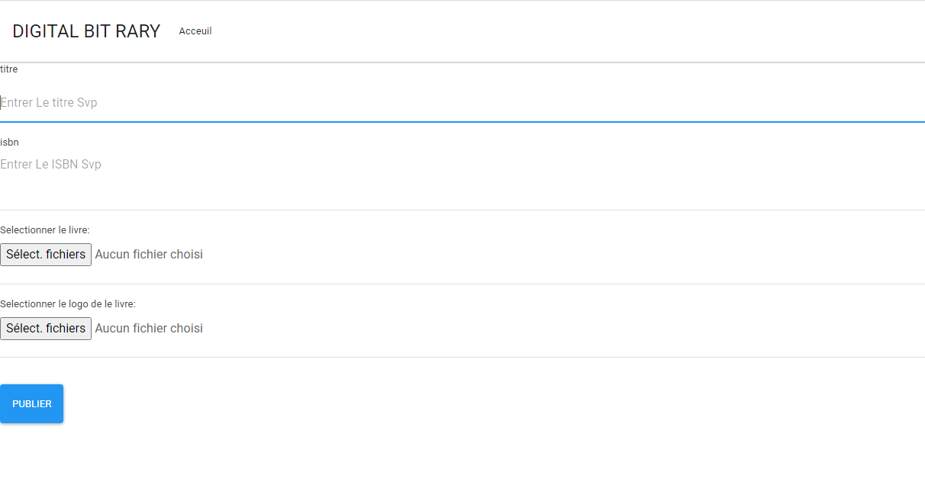
Web Pages
Publish page :

Slide 19
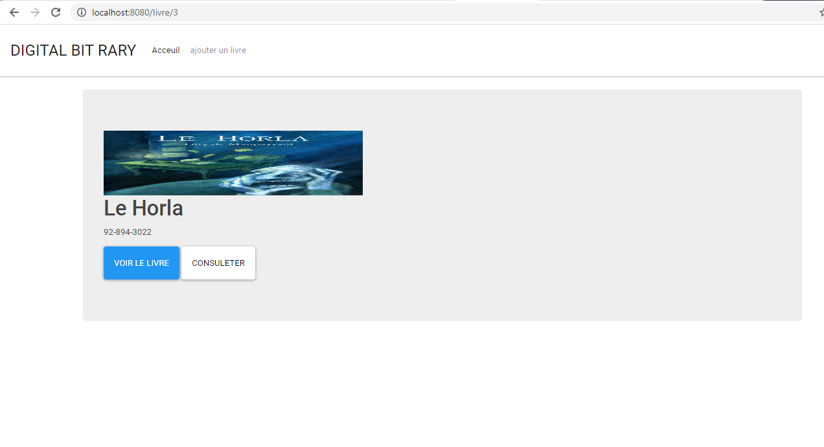
Web Pages
Examine page :

Slide 20
Conclusion
Many users nowadays has began slowly to move into eBooks as it more accessible from classic books , portable (users can open an entire library on his device), ecofriendly, low cost and life time durable .....

Slide 21
THANK YOU

